Slide 1
GAINS FROM TRADE WITHOUT LUMP-SUM COMPENSATION Authors: Avinash Dixit and Victor Norman
Presented by:
Mirza Kashif
Muhammad Usman
Abdul Rehman

Slide 2
Summary
Distributional effects of trade
Trade can lead to gains for both countries involved
Unequal distribution of gains
Notes:
This paper explores the distributional effects of trade in a scenario where there is no lump-sum compensation available to compensate losers in trade
Trade can lead to gains for both countries involved, even if there are differences in productivity
However, the distribution of these gains may not be equal

Slide 3
Summary
Two countries, Two goods
Comparative advantage
Incomplete specialization
Notes:
The authors use a model where there are two countries, each producing two goods
They assume that there are productivity differences between the countries, which leads to a comparative advantage in producing one of the goods
The authors also assume that there is incomplete specialization, meaning that each country produces some of both goods

Slide 4
Summary
Smaller gains in a scenario where all individuals are compensated through lump-sum payments
Income inequality
Productivity differences & the elasticity of substitution
Notes:
The authors show that in this scenario, there are still gains from trade overall, but the gains are smaller than in a scenario where all individuals are compensated through lump-sum payments
The authors also explore the impact of trade on income inequality within countries
They show that trade tends to increase income inequality, but the magnitude of the effect depends on the degree of productivity differences between the countries and the elasticity of substitution between the goods

Slide 5
Summary
Compensation mechanisms
Gains may be smaller and there may be winners and losers
Notes:
Overall, Dixit and Norman's model highlights the important role that compensation mechanisms play in determining the distributional effects of trade
They demonstrate that while there are still gains from trade even in the absence of lump-sum compensation, the gains may be smaller and there may be winners and losers

Slide 6
Model Identification
Ricardian Model of Trade lays its foundation on the basis of a single factor of production, Labor, which is divided among the sectors which then lead to the production possibilities.
The Model also incorporates idea of comparative advantage but in no terms talks about distribution of income.
The model used in the article cannot be regarded as the Ricardian model as the model explicitly talks about distribution of income.

Slide 7
Model Identification
Specific Factors Model of Trade assumes that an economy produces two goods and it allocates available between two sectors, in other words it assumes labor to be a mobile factor where as other factors are said to be sector specific.
The model used in the article cannot be specific factor model as the authors make no mention of a third factor or labor being a mobile factor.
Heckscher-Ohlin Model says that a country indulges in trade of a good it has relative abundance in. Trade is possible under this model as factor endowments differ in abundance across countries.
The Model used in the article cannot be regarded as the Heckscher-Ohlin Model as it in no terms mentions the abundance of factor endowments.

Slide 8
Model Identification
Standard Trade Model amalgamates the ideas behind Ricardian and Heckscher-Ohlin Models. Differences in labor skills, labor productivity, capital and technology differences result in gains from trade.
These differences determine the productivity possibility frontier.
The PPF is what determines the relative supply function for the country.
The Standard Trade model also incorporates the income distribution be government intervention by imposing Import Tariffs.
The model used in the article shares many similarities to the Standard Trade Model as the production possibility frontier is said to be the aggregate supply which is also the case for the standard trade model.
The iso value line is also present whose slope is mentioned to be the relative price.
The article also mentions of the taxes and subsidies as a tool for even distribution of income.

Slide 9
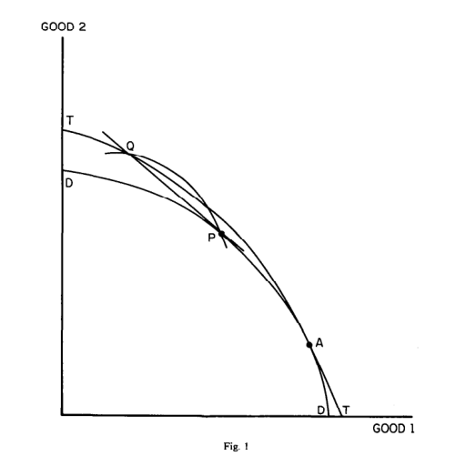
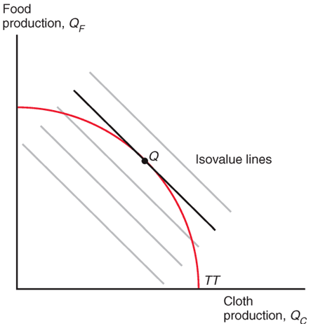
Model Identification

Slide 10
Part 3: Related to Pakistan
Privileges of free trade with many countries such as Malaysia, China & Sri-Lanka
South Asian Association for Regional Cooperation (SAARC)
Trade contracts with Turkey and Indonesia.
Notes:
Pakistan is a country with privileges of free trade with many countries such as Malaysia, China & Sri-Lanka. It is also a part of South Asian Association for Regional Cooperation (SAARC) which basically improves the trade terms economically within its members. It also has some other trade contracts with Turkey and Indonesia.

Slide 11
Pakistan trade policy has seen several changes
Reducing the regulation problems in its framework
Reducing quotas and tariffs placed on global trade.
Still face major problems and diversify
Energy costs
Productivity problems
Barriers placed by some trading countries.
Notes:
Pakistan Trade policy has seen several changes, mainly moving towards benefitting its Trading system, Reducing the regulation problems in its framework, and reducing quotas and tariffs placed on global trade.
we still face major problems in enhancing Competitiveness in International Market, and Diversifying in many factors such as, energy costs, productivity problems, and barriers placed by some trading countries

Slide 12
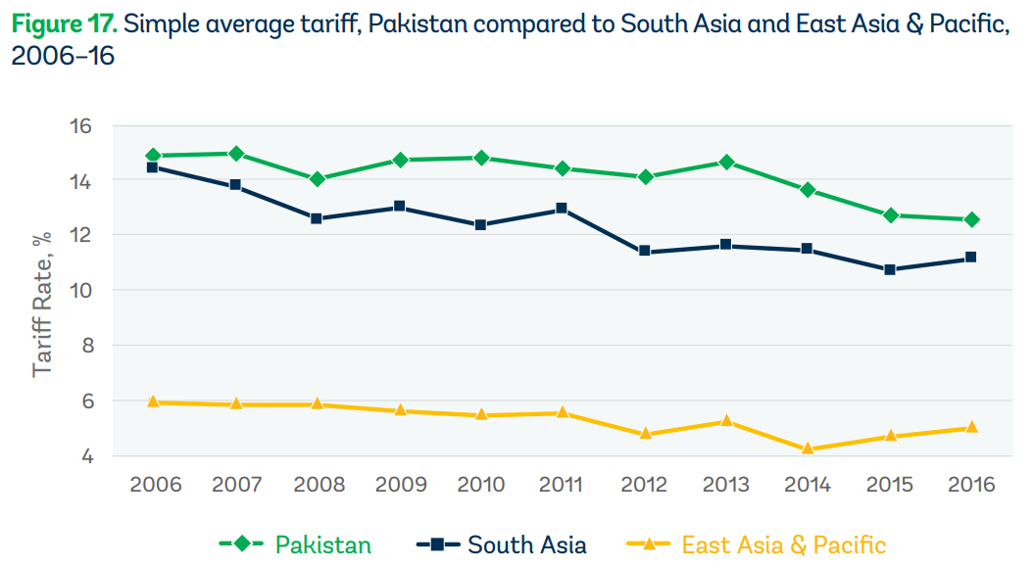
Notes:
Pakistan had a falling trend from 15% to 12.8% from 2006-2016. But South Asia and East Asia & Pacific were still having lower tariffs in all the years.

Slide 13
Protection tools like, regulatory duties (RDs) and firm-specific statutory regulatory orders (SROs)
help offset efforts to reduce tariffs in Pakistan.
In some cases high tariffs, protect our domestic goods production
Notes:
We should try to Introducing some other protection tools like, regulatory duties (RDs) and firm-specific statutory regulatory orders (SROs) which will help offset efforts to reduce tariffs in Pakistan. Sometimes, the aim of high tariffs.
These two tools can help also to protect our domestic goods production.

Slide 14
To improve the framework (Trade Reforms)
Increasing protection of intellectual property of people
Making regulations transparent and predictable for everyone
Expanding the market by accessing the Multi-Lateral or Bi-Lateral Negotiations.
Notes:
To improve the framework and improve trade conditions Pakistan needs to introduce trade reforms such as increasing protection of intellectual property of people, making regulations transparent and predictable for everyone, and expanding the market by accessing the Multi-Lateral or Bi-Lateral Negotiations.

Slide 15
Dixit and Norman Model (1986) Pareto Improvement can occur due to free trade (Gains from trade instead of lump sump transfers)
Pakistani framework, low level of Productivity compared to other countries.
Low efficiency and productivity
Produce Comparative advantage Goods and Trade in which no CA
CA: Cotton and Textile (Abundant Cotton Crop)
Low Labor Costs
Notes:
The author Dixit and Norman (1986) emphasized on Pareto Improvement can occur due to free trade, if the gains from trade and other redistributive tools can be used instead of lump-sum transfers.
Pakistan is a country with low efficiency and productivity among many other developing countries which translates also to the International Sector
look at the gains from Trade if it specializes in the production of goods in which it has a comparative advantage in and trading those goods which are not produced effectively and efficiently by Pakistan.
Cotton and Textile are the goods that Pakistan Produce because we have abundant crop supply of Cotton and Pakistan being a third world countries have low labor costs. So, Pakistan can trade Cotton and Textile with other countries and get the goods in which it does not have a comparative advantage such as Medicine, Automobiles, and High-Tech Machinery

Slide 16
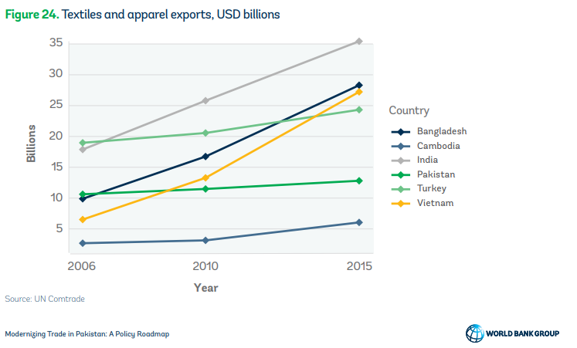
Notes:
Pakistan Textiles and apparel exports were on the value of USD 10.6 billion dollars in 2006, and only rose to 12.8 billion dollars in the year 2015.
Vietnam Textiles exports rose exponentially by 22 billion Dollars between 2006 to 2015
Bangladesh exports rose from 9.9 billion Dollar to 28.3 billion Dollar between 2006 to 2015
Pakistan had slow growth in Textile sector, due to which it is losing sales in the international market to its competitor’s.
Exporting more in the year 2006 compared to Vietnam and Bangladesh.

Slide 17
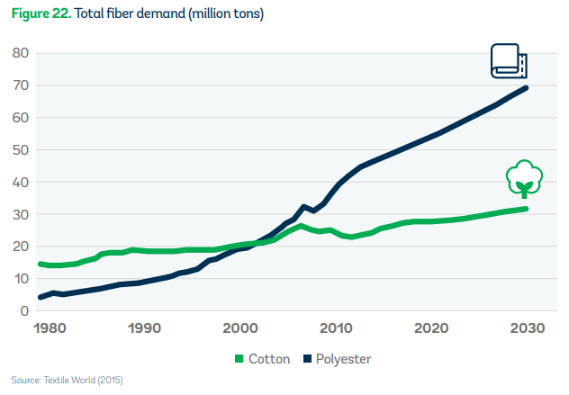
Notes:
As Pakistani apparel industry is dominated by the production of low-value, cotton-based apparel, using poor-quality textiles sourced domestically
There is one notable exception: denim. Pakistan has been relatively successful in using its rugged cotton to produce globally competitive denim products, particularly trouser.
The above Graph shows that Pakistan’s Cotton Demand rose but not incrementally from 15 million tons in 1980 to 28 million tons in 2020.

Slide 18
Dixit Norman [Distributional effects of trade: Some Winners Some Losers(Infant Industries)]
Compensate the negatively affected: implement policies
Retraining programs
Infrastructure investments,
Social Safety Nets
Benefits from CA and trade with other countries but with fair policies of distributional effects of trade and its policy implementation
Notes:
Dixit Norman Model also says that distributional effects of trade should be put into consideration as Trade makes some Countries better off and some countries worse off. So, some Subsidiaries in Pakistan are made better off, but making the other worse off as it leads to Infant industry be put at risk of increased competition exposure from Foreign Companies.
Concluding that Dixit-Norman model suggest that Pakistan could benefit from producing the good it has a comparative advantage in and trade it with other countries for other countries goods in which they have a comparative advantage, but to do it fairly policymakers in Pakistan will need to look at the distributional effects of trade and its policy implementation.

Slide 19
Modernizing Trade in Pakistan: Policy Reform Handbook
Benefits of free trade, and role of trade policy reforms to reach pareto improvement.
Uses Taxes and subsidies on factors to use a redistributive tool in case of compensating losers
Challenges of implementing trade policy
Information requirements
Political economy factors
External shocks.
Notes:
considers benefits of free trade, and role of trade policy reforms to reach pareto improvement.
Uses Taxes and subsidies on factors to use a redistributive tool in case of compensating losers from trade liberalization to achieve Pareto Improvement

Slide 20
Pakistan’s need for public disclosure and transparency in trade related decision
Trade Negatively Impacted
Inadequate infrastructure
Complex regulations
Corruption in Pakistan leading to negative effects on trade
Notes:
Pakistan’s need for public disclosure and transparency in trade related decision making to build trust among trading countries

